Slide 1

19CSE301- Computer Networks

Slide 2
Course Details
Course Outcomes
Syllabus Outline
Assessment Plan
Case study
3 Members per Team
Has to follow the case study Template

Slide 3
Agenda
Basics of IT Infrastructure
Network Cabling
Network Symbols
IP addressing
LAN Basics

Slide 4
Basics of IT Infrastructure
Switches
Routers/ Firewall
IDS/ IPS
Domain controller
File server, Application server and Database servers
https://www.youtube.com/watch?v=PBWhzz_Gn10 - Network Warrior video for beginers

Slide 5
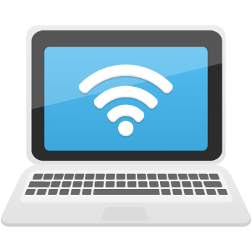
Simple network
Wired Network
UTP – Cross cable is enough to connect two PCs
A
B
Wireless network (Ad-hoc)
Both A & B can communicate directly using wireless network interface card without any network device
B
A

Slide 6
Small network
Wired Network
A
B
Hub/ Switch
C
D
To connect more than 2 system we need a device either hub or switch (also called as intelligent hub)

Slide 7
Graphic Symbols
Bridge
Switch
Router
Access server
ISDN switch
Multi-layer switch
Network switch
DSU/CSU
Personal
computer
File Server
Data Service Unit/ Channel Service Unit
Modem
Web Server
WAN “cloud”
VLAN
(Color May Vary)
Hub
Network Cloud or Broadcast Domain
Ethernet
Fast Ethernet
Serial Line
Circuit Switched Line
Notes:
Purpose: This figure identifies the symbols typically used throughout the graphical presentations of this course.

Slide 8
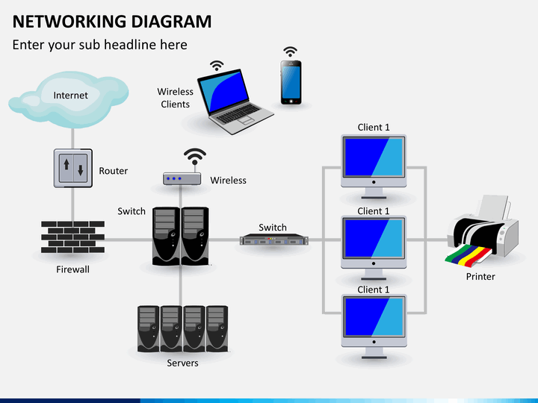
Basic of IT Infrastructure

Slide 9
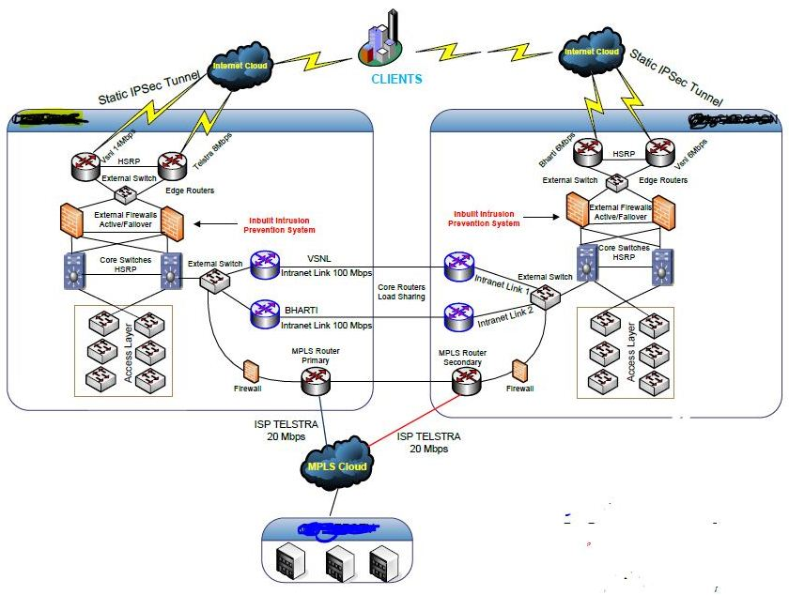
Basics of IT Infrastructure

Slide 10
Network devices and purpose
Network device | Purpose | Remarks
Hub | To connect more than 2 system | It is out dated as it is very slow and does broad casting
Switch | To connect more than 2 system | It is also called intelligent hub, it does unicasting and very fast
Bridge | To connect different network (based on various IP address scheming) | Slow and outdated
Router | To connect different network (based on various IP address scheming) | Latest and currently in use
Firewall | To create wall (secure) between trusted (internal and external (untrusted network)
VPN | Establish secure connection to trusted network over public network (internet) | e.g. work from home now
IDS/ IPS | Detect and prevent intrusion attempts by hackers

Slide 11
IT Industry roles and responsibility
Roles | Responsibility | Skill set required | Certificates related to the work
Desktop Engineer | To trouble and install operating system (OS) related issues | Hardware and OS | Comptia A+
Server Engineer | Setup and operate servers | Services and OS | MCSE, RHCE etc.,
Network Engineer | Setup and trouble shoot network | Cabling, network commands, sub netting, VPN, routing, switching etc., | Comptia N+, CCNA etc.,
Security Engineer | Detect and Prevent intrusions/ malicious activities | Firewall setup, VPN, IDS & IPS and other security technologies | Comptia S+
Information Security Officer | To Design and periodically review entire IT infrastructure | Generally knowledge on all of the above | Comptia S+, CISSP, CISA etc.,

Slide 12
Network Device Domains
Hub
Bridge
Switch
Router
Collision Domains:
1 4 4 4
Broadcast Domains:
1 1 1 4
Notes:
Emphasize: This figure summarizes the different collision domains and broadcast domains on various network devices. It is important that students understand the difference between the two domains.

Slide 13
Hubs: One Collision Domain
More end stations means more collisions
CSMA/CD is used
Notes:
Purpose: This figure compares hubs in a CSMA/CD environment to a highway with multiple access points.
Emphasize: The more entrance points onto the highway, the greater the likelihood for a collision to occur. Likewise, the more end stations on a hub trying to access the line, the more collisions occur.

Slide 14
Using Routers to Provide Remote Access
Modem or ISDN TA
Telecommuter
Mobile User
Branch Office
Main Office
Internet
Notes:
Purpose: Routers provide access into the corporate network via WAN connections.
Emphasize: A main office must be able to support multiple types of connections.
Note: The lightning bolt represents a WAN connection. The dotted lines represent DDR connections. The solid bolts can be packet switched or leased lines.

Slide 15
Switches
Switch
Memory
Each segment has its own collision domain
Broadcasts are forwarded to all segments
Notes:
Purpose: This figure compares the switch to a highway.

Slide 16
Cabling the Campus
Legend
Fast Ethernet/
Ethernet
ISDN
Dedicated
Core_Server
core_sw_a
Leased Line/
Frame Relay
ISDN Cloud
Notes:
Purpose: this figure highlights the LAN network. In this section, students will learn how to cable the LAN.
Note: The figure illustrates two workgroup LANS, both connecting into core switches.

Slide 17
Cabling the WAN
Legend
FastEthernet/
Ethernet
ISDN
Dedicated
ISL
Core_Server
core_sw_b
core_sw_b
core_sw_a
Leased Line/
Frame Relay
ISDN Cloud
Notes:
Purpose: This figure highlights the WAN network. In this section, students will learn how to cable the WAN.
Note: The figure illustrates two workgroup WANs. One is an ISDN connection to a home office. The other illustrates a serial Frame Relay or leased line connection to a branch office.

Slide 18
Types of servers and purpose
Servers | Purpose
Web Server | It provides static content to a web browser by loading a file from a disc and transferring it across the network to the user’s web browser. This exchange is intermediates by the browser and the server, communicating using HTTP
Application Server | Also known as a type of middleware, it occupies a substantial amount of computing region between database servers and the end user, and is commonly used to connect the two.
Database Server | To provide database service to the application and web servers.
Mail Server | It transfers and stores emails over corporate networks through LANs, WANs and across the Internet.
FTP (File) Server | It works on one of the oldest of the Internet services, the file transfer protocol. It provides a secure file transfer between computers while ensuring file security and transfer control.
Audio/Video Server | It provides multimedia capabilities to websites by helping the user to broadcast streaming multimedia content.
Telnet Server | It enables the users to log on to a host computer and execute tasks as if they are working on a remote computer.

Slide 19
Types of servers and purpose
Network device | Purpose
Chat Server | It serves the users to exchange data in an environment similar to Internet newsgroup which provides real-time discussion capabilities.
Proxy Server | It acts as a mediator between a client program and an external server to filter requests, improves performance and share connections.
IRC Server | It is an ideal option for those looking for real-time discussion capabilities. Internet Relay Chat comprises different network servers that enable the users to connect to each other to an IRC network.
Fax Server | It is one of the best options for organizations that seek minimum incoming and outgoing telephone resources, but require to fax actual documents.
Virtual Servers | A virtual server is just like a physical computer, it is committed to an individual customer’s demands, can be individually booted and maintains the privacy of a separate computer. Basically, the distance among shared and dedicated (hosting) servers is reduced providing freedom to other customers, at a less cost.

Slide 20
IP Addressing

Slide 21
IP Address
What is IP Address?
An IP Address is a numeric identifier assigned to each machine on an IP Network
It is a Software address , it was designed to allow a host on one network to communicate other.

Slide 22
IP Terminology
Several Important terms to understand IP
BIT :- A bit is one digit; either a 1 or a 0
BYTE :- A byte is 7 or 8 bits, depending on whether parity, always assume a byte is 8 bits
OCTET:- An octet, made up of 8 bits

Slide 23
IP Address
An IP address consists of 32 bits of Information. These bits are divided into four sections, referred as octets or bytes, each containing 1 byte (8 bits).
Example of IP:
192.168.10.1

Slide 24
IP Classes
Class A
Class B
Class C
Class D
Class E

Slide 25
Summary:
8 bits | 8 bits | 8 bits | 8 bits
Class A :
Network | Host | Host | Host
Class B :
Network | Network | Host | Host
Class C :
Network | Network | Network | Host
Class D :
Multicast
Class E :
Research

Slide 26
Address ranges
Class A
00000000 = 0
01111111 = 126
Class B
10000000 = 128
10111111 = 191
Class C
11000000 =192
11011111 =223
Class D
=224
=239
Class E
=240
=255

Slide 27
More in Detail will be learnt
in the forthcoming classes

Slide 28
LAN BASICS WAN BASICS

Slide 29
LAN BASICS & DEVICES

Slide 30
AGENDA
Networking History
Network Topologies
OSI Reference Model
Networking Standards
Media For LAN
Structured Cabling
LAN Devices
Wireless LAN
Notes:
This module covers the very basics of internetworking. We’ll start with a little history that describes how the networking industry evolved. We’ll then move on to a section that describes how a LAN is built: essentially the necessary components (like NIC cards and cables). We then cover LAN topologies. And finally we’ll discuss the key networking devices: hubs, bridges, switches, and routers.
This module is an overview only. It will familiarize you with much of the vocabulary you hear with regards to networking. Some of these concepts are covered in more detail in later modules.

Slide 31
TELEPHONE NETWORK
Bell Telephone
Analog Network
Notes:
But it’s really the telephone network that has had the greatest impact on how businesses communicate and connect today. Until 1985, the Bell Telephone Company, now known as AT&T, owned the telephone network from end to end. It represented a phenomenal network, the largest then and still the largest today.
Let’s take a look at some additional developments in the communications industry that had a direct impact on the networking industry today.

Slide 32
TELEPHONE NETWORK
MCI
Bell Atlantic
AT&T
Pacific Bell
Notes:
The break up of AT&T in 1984 opened the door for other competitors in the telecommunications market. Companies like Microwave Communications, Inc. (MCI), and Sprint. Today, when you make a phone call across the country, it may go through three or four different carrier networks in order to make the connection.
Now, let’s take a look at what was happening in the computer industry about the same time.

Slide 33
1960s–1970s COMMUNICATIONS
Digital Network
Low-Speed Access Lines
IBM Host Computer Systems Network Architecture (SNA)
Application Programs
Database
Printing
Notes:
In the 1960’s and 1970’s, traditional computer communications centered around the mainframe host. The mainframe contained all the applications needed by the users, as well as file management, and even printing. This centralized computing environment used low-speed access lines that tied terminals to the host.
These large mainframes used digital signals – pulses of electricity or zeros and ones, what is called binary -- to pass information from the terminals to the host. The information processing in the host was also all digital.

Slide 34
WHY COMPUTER NETWORKS
Communication Medium
Resource sharing
Higher Reliabilty
Higher flexibilty
Lower cost
Incremental expansion

Slide 35
TYPES OF NETWORKS
LAN
WAN
CAN
MAN

Slide 36
LOCAL AREA NETWORK--LAN
What is a LAN?
A collection of computers, printers, modems, and other devices that can communicate with each other in a small area (< ~ 300 m or 1000 feet)
What are the components?
Computers, Operating system (OS), Network Interface Card (NIC), Hubs, Switches
Notes:
The term local-area network, or LAN, describes of all the devices that communicate together—printers, file server, computers, and perhaps even a host computer. However, the LAN is constrained by distance. The transmission technologies used in LAN applications do not operate at speed over long distances. LAN distances are in the range of 100 meters (m) to 3 kilometers (km). This range can change as new technologies emerge.
For systems from different manufacturers to interoperate—be it a printer, PC, and file server—they must be developed and manufactured according to industry-wide protocols and standards.
More details about protocols and standards will be given later, but for now, just keep in mind they represent rules that govern how devices on a network exchange information. These rules are developed by industry-wide special interest groups (SIGs) and standards committees such as the Institute of Electrical and Electronics Engineers (IEEE).

Slide 37
LOCAL AREA NETWORKS
LANs are designed to:
Operate within a limited geographic area
Allow multi-access to high-bandwidth media
Control the network privately under local administration
Provide full-time connectivity to local services
Connect physically adjacent devices
Notes:
Most of the network administrator’s tasks deal with LANs. Major characteristics of LANs are:
The network operates within a building or floor of a building. The geographic scope for ever more powerful LAN desktop devices running more powerful applications is for less area per LAN.
LANs provide multiple connected desktop devices (usually PCs) with access to high-bandwidth media.
An enterprise purchases the media and connections used in the LAN; the enterprise can privately control the LAN as it chooses.
LANs rarely shut down or restrict access to connected workstations; local services are usually always available.
By definition, the LAN connects physically adjacent devices on the media.
So let’s look at the components of a LAN.

Slide 38
NETWORK OPERATING SYSTEM (OS)
Software that allows communicating and sharing of data and network resources
Examples:
AppleTalk
NetWare
Banyan VINES
MS TCP/IP ( Windows)
PC or Workstation
Loaded with NOS
Notes:
In order for computers to be able to communicate with each other, they must first have the networking software that tells them how to do so. Without the software, the system will function simply as a “standalone,” unable to utilize any of the resources on the network.
Network operating software may by installed by the factory, eliminating the need for you to purchase it, (for example AppleTalk), or you may install it yourself.
The computer shown here may be a workstation or a personal computer (PC).

Slide 39
NETWORK INTERFACE CARD
Amplifies electronic signals
Packages data for transmission
Physically connects computer to transmission media (cable)
PC or Workstation
Loaded with NOS
Connector Port
Network Interface
Card (NIC)
Notes:
In addition to network operating software, each network device must also have a network interface card. These cards today are also referred to as adapters, as in “Ethernet adapter card” or “Token Ring adapter card.”
The NIC card amplifies electronic signals which are generally very weak within the computer system itself. The NIC is also responsible for packaging data for transmission, and for controlling access to the network cable. When the data is packaged properly, and the timing is right, the NIC will push the data stream onto the cable.
The NIC also provides the physical connection between the computer and the transmission cable (also called “media”). This connection is made through the connector port. Examples of transmission media are Ethernet, Token Ring, and FDDI.

Slide 40
WIRING HUB
PC or Workstation
Loaded with NOS
Printer
(Also has a NIC)
Wiring
Hub
NIC
Serves as center of network
Contains multiple independent but connected modules where network equipment can be connected
Notes:
In order to have a network, you must have at least two devices that communicate with each other. In this simple model, it is a computer and a printer. The printer also has an NIC installed (for example, an HP Jet Direct card), which in turn is plugged into a wiring hub. The computer system is also plugged into the hub, which facilitates communication between the two devices.
Additional components (such as a server, a few more PCs, and a scanner) may be connected to the hub. With this connection, all network components would have access to all other network components.
The benefit of building this network is that by sharing resources a company can afford higher quality components. For example, instead of providing an inkjet printer for every PC, a company may purchase a laser printer (which is faster, higher capacity, and higher quality than the inkjet) to attach to a network. Then, all computers on that network have access to the higher quality printer.

Slide 41
CABLES or TRANSMISSION MEDIA
Connectors
PC or Workstation
Loaded with NOS
Printer
(Also has a NIC)
Wiring Hub
NIC
Cable
Physical environments through which transmission signals pass
Twisted pair
Coaxial cable
Connectors (RJ-11, RJ-45, etc.)
RJ-45
Connector
Fiber-optic cable
Atmosphere
Notes:
The wires connecting the various devices together are referred to as cables.
Cable prices range from inexpensive to very costly and can comprise of a significant cost of the network itself.
Cables are one example of transmission media. Media are various physical environments through which transmission signals pass. Common network media include twisted-pair, coaxial cable, fiber-optic cable, and the atmosphere (through which microwave, laser, and infrared transmission occurs). Another term for this is “physical media.”
Note that not all wiring hubs support all medium types.
The other component shown in this slide is the connector.
As their name implies, the connector is the physical location where the NIC card and the cabling connect.
Registered jack (RJ) connectors were originally used to connect telephone lines. RJ connectors are now used for telephone connections and for 10BaseT and other types of network connections. Different connectors are able support different speeds of transmission because of their design and the materials used in their manufacture.
RJ-11 connectors are used for telephones, faxes, and modems. RJ-45 connectors are used for NIC cards, 10BaseT cabling, and ISDN lines.

Slide 42
NETWORK CABLING
Media connecting network components
NIC cards take turns transmitting on the cable
LAN cables only carry one signal at a time
WAN cables can carry multiple signals simultaneously
Three primary types of cabling
Twisted-pair (or copper)
Coaxial cable
Fiber-optic cable
Notes:
Cable is the actual physical path upon which an electrical signal travels as it moves from one component to another.
Transmission protocols determine how NIC cards take turns transmitting data onto the cable. Remember that we discussed how LAN cables (baseband) carry one signal, while WAN cables (broadband) carry multiple signals. There are three primary cable types:
Twisted-pair (or copper)
Coaxial cable and
Fiber-optic cable

Slide 43
TWISTED PAIR (UTP & STP)
Color-Coded
Plastic Insulation
STP only:
Shielded Insulation
to Reduce EMI
Twisted-Pair
Outer Jacket
Speed and throughput: 10/100/1000 Mbps
Relative cost: Least costly
Media and connector size: Small
Maximum cable length: 100 m
RJ-45
Connector
Notes:
Unshielded twisted-pair (UTP) is a four-pair wire medium used in a variety of networks. UTP does not require the fixed spacing between connections that is necessary with coaxial-type connections. There are five types of UTP cabling commonly used as shown below:
Category 1: Used for telephone communications. It is not suitable for transmitting data.
Category 2: Capable of transmitting data at speeds up to 4 Mbps.
Category 3: Used in 10BaseT networks and can transmit data at speeds up to 10 Mbps.
Category 4: Used in Token Ring networks. Can transmit data at speeds up to 16 Mbps.
Category 5: Can transmit data at speeds up to 100 Mbps.
Shielded twisted-pair (STP) is a two-pair wiring medium used in a variety of network implementations. STP cabling has a layer of shielded insulation to reduce EMI. Token Ring runs on STP.
Using UTP and STP:
Speed is usually satisfactory for local-area distances.
These are the least expensive media for data communication. UTP is cheaper than STP.
Because most buildings are already wired with UTP, many transmission standards are adapted to use it to avoid costly re-wiring of an alternative cable type.

Slide 44
CO-AXIAL CABLE
Braided Copper Shielding
Outer Jacket
Plastic Insulation
Copper Conductor
BNC Connector
Speed and throughput: 10/100 Mbps
Relative cost: More than UTP, but still low
Media and connector size: Medium
Maximum cable length: 200/500 m
Notes:
Coaxial cable consists of a solid copper core surrounded by an insulator, a combination shield and ground wire, and an outer protective jacket.
The shielding on coaxial cable makes it less susceptible to interference from outside sources. It requires termination at each end of the cable, as well as a single ground connection.
Coax supports 10/100 Mbps and is relatively inexpensive, although more costly than UTP.
Coaxial can be cabled over longer distances than twisted-pair cable. For example, Ethernet can run at speed over approximately 100 m (300 feet) of twisted pair. Using coaxial cable increases this distance to 500 m.

Slide 45
FIBER OPTIC CABLE
Kevlar Reinforcing
Material
Plastic
Shield
Outer Jacket
Glass Fiber
and Cladding
Single mode: One stream of laser-generated light (100 km)
Multimode: Multiple streams of LED-generated light (2 km)
Speed and throughput: 1000+ Mbps
Average cost per node: Most expensive
Media and connector size: Small
Maximum cable length: Up to 2 km (Multimode)
Multimode
Connector
Notes:
Fiber-optic cable consists of glass fiber surrounded by shielding protection: a plastic shield, kevlar reinforcing, and an outer jacket. Fiber-optic cable is the most expensive of the three types discussed in this section, but it supports 100+ Mbps line speeds.
There are two types of fiber cable:
Single or mono-mode—Allows only one mode (or wavelength) of light to propagate through the fiber; is capable of higher bandwidth and greater distances than multimode. Often used for campus backbones. Uses lasers as the light generating method. Single mode is much more expensive than multimode cable. Maximum cable length is 100 km.
Multimode—Allows multiple modes of light to propagate through the fiber. Often used for workgroup applications. Uses light-emitting diodes (LEDs) as light generating device. Maximum cable length is 2 km.

Slide 46
NETWORK TOPOLOGIES
The Fashion of Connecting the Computers in a Network shall be termed as Topology.
There are different types of Topologies as below.
Bus
Ring
Star
Mesh

Slide 47
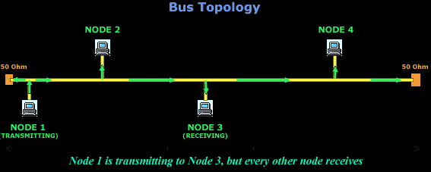
bus

Slide 48
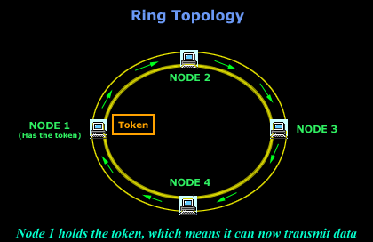
Ring

Slide 49
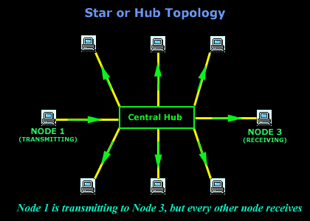
Star

Slide 50
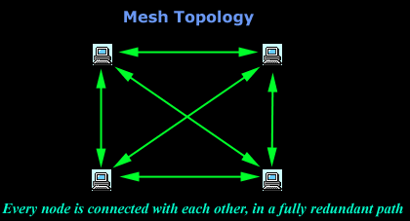
Mesh

Slide 51
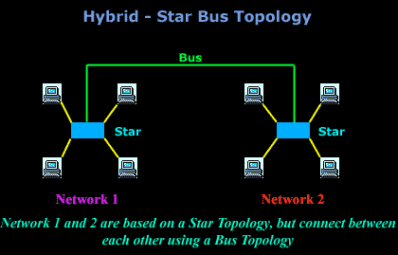
Hybrid-Star & Bus

Slide 52
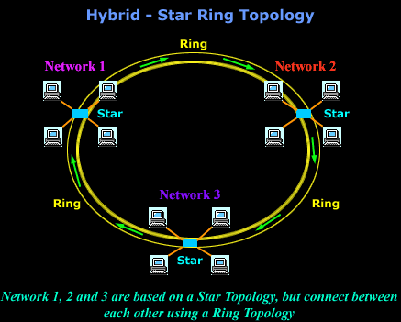
Hybrid –Star & Ring

Slide 53
Metropolitan Area Network
A metropolitan area network (MAN) is a computer network that interconnects users with computer resources in a geographic region of the size of a metropolitan area.
The term MAN is applied to the interconnection of local area networks (LANs) in a city into a single larger network which may then also offer efficient connection to a wide area network.

Slide 54
A wide area network (WAN) is a telecommunications network that extends over a large geographic area for the primary purpose of computer networking. Wide area networks are often established with leased telecommunication circuits.

Slide 55
A Controller Area Network (CAN) is a serial bus network of microcontrollers that connects devices, sensors and actuators in a system or sub-system for real-time control applications.
There is no addressing scheme used in controller area networks, as in the sense of conventional addressing in networks (such as Ethernet ).

Slide 56
DEVICES FUNCTION AT LAYERS
7 Application
6 Presentation
5 Session
4 Transport
3 Network
2 Data Link
1 Physical
NIC Card
Notes:
Let’s put this in some context. You are already familiar with different networking devices such as hubs, switches, and routers. Each of these devices operate at a different level of the OSI Model.
NIC cards receive information from upper level applications and properly package data for transmission on to the network media. Essentially, NIC cards live at the lower four layers of the OSI Model.
Hubs, whether Ethernet, or FDDI, live at the physical layer. They are only concerned with passing bits from one station to other connected stations on the network. They do not filter any traffic.
Bridges and switches on the other hand, will filter traffic and build bridging and switching tables in order to keep track of what device is connected to what port.
Routers, or the technology of routing, lives at layer 3.
These are the layers people are referring to when they speak of “layer 2” or “layer 3” devices.
Let’s take a closer look at the model.

Slide 57
HOST LAYERS
}
7 Application
6 Presentation
5 Session
4 Transport
3 Network
2 Data Link
1 Physical
Host layers: Provide accurate data delivery between computers
Notes:
The upper four layers, Application, Presentation, Session, and Transport, are responsible for accurate data delivery between computers. The tasks or functions of these upper four layers must “interoperate” with the upper four layers in the system being communicated with.

Slide 58
MEDIA LAYERS
}
7 Application
6 Presentation
5 Session
4 Transport
3 Network
2 Data Link
1 Physical
Host layers: Provide accurate data delivery between computers
}
Media layers: Control
physical delivery of messages over the network
Notes:
The lower three layers – Network, Data Link and Physical -- are called the media layers. The media layers are responsible for seeing that the information does indeed arrive at the destination for which it was intended.

Slide 59
More in Detail on the protocols
will be learnt in coming classes

Slide 60
Networking Standards

Slide 61
IEEE - 802.3 STANDARDS
802.3 (1985) Base standard (10B5)
802.3a (1992) 10B2 Ethernet over thin coaxial cable
802.3b (1985) Broadband Ethernet (using coaxial TV cable, now seldom used)
802.3c (1985) Improved definition of a Repeater
802.3d (1987) Definition of Ethernet for Fibre(10BFOIRL) (now seldom used)
802.3e (1987) 1Base5 or StarLAN (now seldom used)

Slide 62
LAN DEVICES
Hubs
Bridges
Switches
Notes:
Let’s now take a look at some of the devices that move traffic around the network.
The approach taken in this section will be simple. As networking technology continues to evolve, the actual differences between networking devices is beginning to blur slightly. Routers today are switching packets faster and yielding the performance of switches. Switches, on the other hand, are being designed with more intelligence and able to act more like routers. Hubs, while traditionally not intelligent in terms of the amount of software they run, are now being designed with software that allows the hub to be “intelligent” acting more like a switch.
In this section, we’ll keep these different types of product separate so that you can understand the basics. Let’s start off with the hub.

Slide 63
HUB
Device that serves as the center of a star topology network, sometimes referred to as a multiport repeater, or in Ethernet, a concentrator; no forwarding intelligence
Notes:
Star topology networks generally have a hub in the center of the network that connects all of the devices together using cabling. When bits hit a networking device, be they hubs, switches, or routers, the devices will strengthen the signal and then send it on its way.
A hub is simple a multiport repeater. There is usually no software to load, and no configuration required (i.e. network administrators don’t have to tell the device what to do).

Slide 64
Hubs
123
126
124
127
Hub
125
Data
Data
128
Amplifies signals
Propagates signals through the network
Does not filter data packets based on destination
No path determination or switching
Used as network concentration point
Notes:
Hubs operate very much the same way as a repeater. They amplify and propagate signals received out all ports, with the exception of the port from which the data arrived.
For example, if system 125 wanted to print on the printer 128, the message would be sent to all systems on Segment 1, as well as across the hub to all systems on Segment 2. System 128 would see that the message is intended for it and would process it.
Devices on the network are constantly listening for data. When devices sense a frame of information that is addressed (and we will talk more about addressing later) for it, then it will accept that information into memory found on the network interface card (NIC) and begin processing the data.
In fairly small networks, hubs work very well. However, in large networks the limitations of hubs creates problems for network managers. In this example, Ethernet is the standard being used. The network is also baseband, only one station can use the network at a time. If the applications and files being used on this network are large, and there are more nodes on the network, contention for bandwidth will slow the responsiveness of the network down.

Slide 65
BRIDGE
Device that connects and passes packets between two network segments.
More intelligent than hub—analyzes incoming packets and forwards (or filters) them based on addressing information.
Notes:
Bridges improve network throughput and operate at a more intelligent level than do hubs. A bridge is considered to be a store and forward device that uses unique hardware addresses to filter traffic that would otherwise travel from one segment to another. A bridge performs the following functions:
Reads data frame headers and records source address/port (segment) pairs
Reads the destination address of incoming frames and uses recorded addresses to determine the appropriate outbound port for the frame.
Uses memory buffers to store frames during periods of heavy transmission, and forwards them when the medium is ready.
Let’s take a look at an example.

Slide 66
Bridge Example
123
126
Bridge
124
127
Hub
Hub
125
128
Segment 1
Corporate Intranet
Segment 2
More intelligent than a hub—can analyze incoming packets and forward (or filter) them based on addressing information
Collects and passes packets between two network segments
Maintains address tables
Different types of bridges: transparent and source route (used primarily in Token Ring LANs)
Notes:
The bridge divides this Ethernet LAN into two segments, each connecting to a hub and then to a bridge port. Stations 123-125 are on segment 1 and stations 126-128 are on segment 2.
When station 124 transmits to station 125, the frame goes into the hub (who repeats it and sends it out all connected ports) and then on to the bridge. The bridge will not forward the frame because it recognizes that stations 124 and 125 are on the same segment. Only traffic between segments passes through the bridge. In this example, a data frame from station 123, 124, or 125 to any station on segment 2 would be forwarded, and so would a message from any station on segment 2 to stations on segment 1.
When one station transmits, all other stations must wait until the line is silent again before transmitting. In Ethernet, only one station can transmit at a time, or data frames will collide with each other, corrupting the data in both frames.
Bridges will listen to the network and keep track of who they are hearing. For instance, the bridge in this example will know that system 127 is on Segment 2, and that 125 is on segment 1. The bridge may even have a port (perhaps out to the Internet) where it will send all packets that it cannot identify a destination for.

Slide 67
SWITCHES
Use bridging technology to forward traffic between ports.
Provide full dedicated data transmission rate between two stations that are directly connected to the switch ports.
Build and maintain address tables called content-addressable memory (CAM) or MAC Address Table
Notes:
Switches use bridging technology to forward traffic between ports. They provide full dedicated transmission rates between two stations that are directly connected to the switch ports. Switches also build and maintain address tables just like bridges do. These address tables are known as “content addressable memory.” Let’s look at an example.

Slide 68
Switching—“Dedicated” Media
Workstation
10-Mbps
UTP Cable
“Dedicated”
31
Switch
34
32
35
100 Mbps
100 Mbps
36
Corporate Intranet
Uses bridging technology to forward traffic (i.e. maintains address tables, and can filter)
Provides full dedicated transmission rate between stations that are connected to switch ports
Used in both local-area and in wide-area networking
All types available—Ethernet, Token Ring, ATM
Notes:
Replacing the two hubs and the bridge with an Ethernet switch provides the users with dedicated bandwidth. Each station has a full 10Mbps “pipe” to the switch. With a switch at the center of the network, combined with the 100Mbps links, users have greater access to the network.
Given the size of the files and applications on this network, additional bandwidth for access to the sever or to the corporate intranet is possible by using a switch that has both 10Mbps and 100Mbps Fast Ethernet ports. The 10Mbps links could be used to support all the desktop devices, including the printer, while the 100Mbps switch ports would be used for higher bandwidth needs.

Slide 69
About our Campus Network
We have a Virtual LAN for each computer lab
All computers in Network are connected to the switch in the Lab in same floor
Switches are interconnected among themselves in the same Network(i,e same floor)
A network cable connects Switch from one floor to another floor
Hence all systems identify themselves with a IP address using the switch.
The subnetworks are interconnected to the main campus server in the main block.

Slide 70
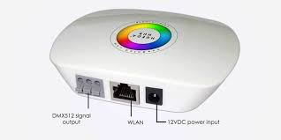

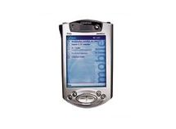

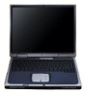
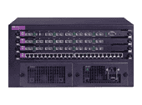
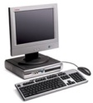


High Level - Campus-Network Diagram
INTERNET
WAN
DMZ
Wifi Controllers
DMZ-Servers
Firewall
LAN
Server VLAN
Other VLANs
CSE VLAN
Core Switches
EEE VLAN
ICTS VLAN
Wireless VLAN
ASB VLAN
Academic Blocks

Slide 71
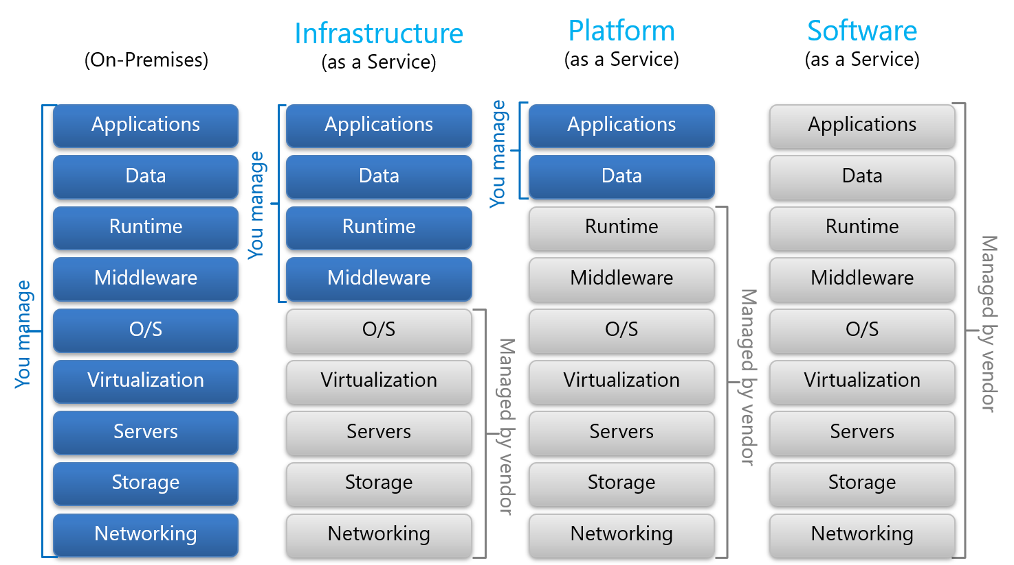
Cloud Service Model

Slide 72
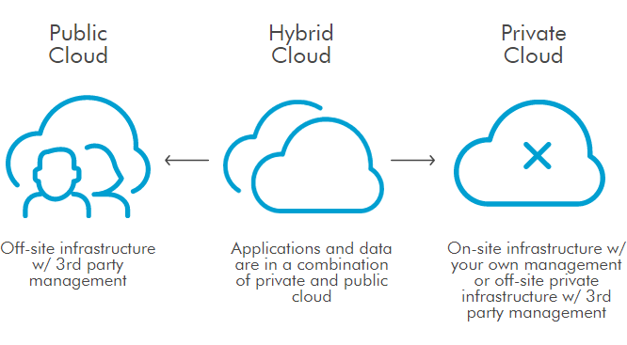
Cloud Deployment Service Model
Our campus has a cloud Infrastructure for Desktop operating systems

Slide 73
Activity #1
Identify a application that has Networking. For example: Airline Ticket Booking, Railway Reservation System
Provide the following details:
1. Type of Network
2. Client Configuration
3. Server Configuration
4. Types of Servers
5. Network Cable and Topology
Provide the details as a online submission in Teams individually .

Slide 74
Thank you

